Slide 1

Module 11: Enabling Usage Tracking
0/5
Analytics: Advanced Server Architect

Slide 2
Module Objectives
After completing this module you will be able to:
  Identify the need to use usage tracking
  Enable usage tracking
Why you need to know:
  Usage tracking enables administrators to monitor database activity

Slide 3
Business Challenges
On first deployment, the Analytics database may not be optimized for the querying that actually occurs
  Queries may not match what was expected, so cache was not seeded with correct queries
  Additional aggregate tables may need to be created
Your company may need to track database usage on a user or departmental level
  Users may be charged for database use
  Regulatory requirements may require usage tracking

Slide 4
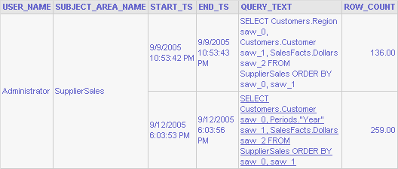
Business Solution
Use Siebel Analytics Usage Tracking to track queries and database usage
  Track query times, number of rows, cache hits, and so forth
  Store results in a database table or log file
  Analyze results using Siebel Analytics or another tool
  Use results for cache seeding, database optimization, or other purposes
Usage data includes users, timestamps, queries, and row counts
Total rows returned by this query
Start and end timestamps

Slide 5
Analyze Usage Tracking Data
Watch for long-running queries (typically ad hoc)
  End user may need training
  May need to assign query blocking/restrictions on how long queries can run, or on number of records returned
  Database may require additional indexes
Perform usage audits for:
  Regulatory compliance
  Security
Determine whether a query should be used to seed the cache or be removed from the cache-seeding queries:
  Number of times a query is run and length of time = candidate for caching
  Number of times a query hits the cache = effective cache

Slide 6
Steps to Perform Usage Tracking
0/3
1. Identify Storage
2. Modify NQSConfig.ini
3. Configure Presentation Catalog

Slide 7
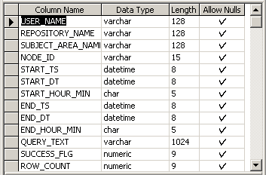
1. Identify Storage
1/3
Create table or identify a file
For table:
  Default name is S_NQ_ACCT
  Use script provided in <SiebelAnalytics>/Schema
  Database should support international characters to store multilingual queries
S_NQ_ACCT

Slide 8
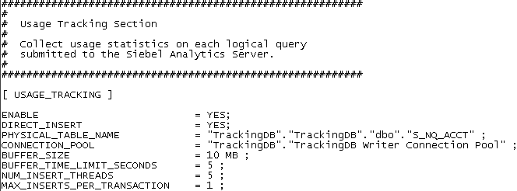
2. Modify NQSConfig.ini to Use Database
2/3
Set ENABLE flag to YES
Other key parameters for storing to a database table:
  Set DIRECT_INSERT to YES
  Specify PHYSICAL_TABLE_NAME and CONNECTION_POOL
    Format for these strings depends on the database used
Complete list of parameters is in Siebel Analytics Installation and Configuration Guide

Slide 9
2. Modify NQSConfig.ini to Use File
2/3
Set DIRECT_INSERT to NO to store usage tracking information in a file
Key parameters for storage to a file:
  Set STORAGE_DIRECTORY to specify where to save the log files
  Set CHECKPOINT_INTERVAL_MINUTES to specify how often to flush the data to disk
  Set FILE_ROLLOVER_INTERVAL_MINUTES to specify how long to keep the current file open before starting a new file
  Set CODE_PAGE to specify the type of output code page for multilingual repositories
Complete list of parameters is in Siebel Analytics Installation and Configuration Guide

Slide 10
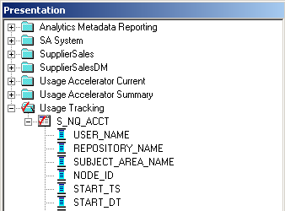
3. Configure Presentation Catalog
3/3
Add usage tracking data source to the Physical layer
Create both a dimension and a fact table representing the usage tracking data
  Supports relationships between objects in usage tracking table
Add the dimension table to the Presentation layer

Slide 11
Query Usage Tracking Data
Use Siebel Answers to examine usage

Slide 12
Summary
This module showed you how to:
  Identify the need to use usage tracking
  Enable usage tracking

Slide 13
Lab
In the lab you will:
  Configure Siebel Analytics to support usage tracking
  Use usage tracking to monitor queries

